Slide 1


Industrial decarbonisation and the green energy transition
A foundation for the next generation

Slide 2

Introduction
Years of experience successfully
establishing brands
repositioning brands
revamping brands
building business credibility and stakeholder trust

Slide 3
The story
1. Business start-up idea and the challenge to Nason Associates
2. What is floating offshore wind?
3. Segmenting the the market and defining the issue to be solved
4. Creating the opportunity and designing the solution
5. Defining stakeholders communities and key messaging
6. The results of the seabed leases
7. The benefit to start-ups and SMEs

Slide 4
1. Business start-up idea
Bringing floating offshore wind (FOW) to market rapidly on an industrial scale,
contributing to the renewable energy supply and
supporting net zero targets.

Slide 5
1. The challenge
Nason Associates needs to establish an authentic and credible ‘major player’ brand as a new market entry into the green energy sector.

Slide 6
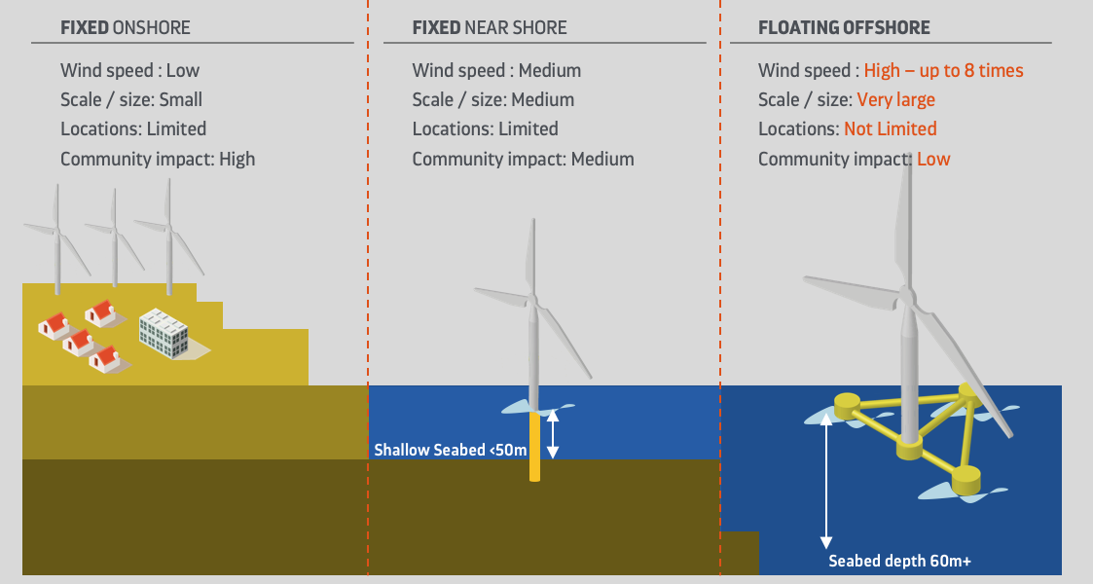
2. What is floating offshore wind (FOW)?

Slide 7
2. Floating wind technology
20MW
2024
Power 55kW 300kW 750kW 1.5MW 1.8MW 3MW 5MW 6MW 8MW 12MW 14MW 16MW
Near shore fixed – eg.Rampion (Brighton) 3.45MW Turbines

Slide 8
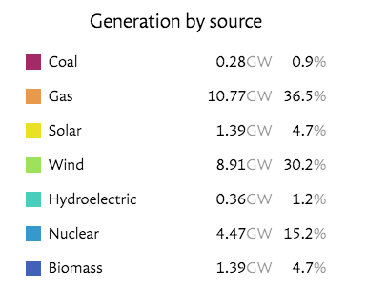
3. Wind energy to the grid now and future potential
National Grid Live - Past Year (Oct)
Floating Wind lease awards
2021 - Appx 8 GW (Leasing round 4)
2022 - Appx 25 GW (Scotwind)
2023 - Appx 5.5 GW (INTOG)
+ Interconnectors appx 1.8GW 6.6%
29.37GW
38.5GW

Slide 9
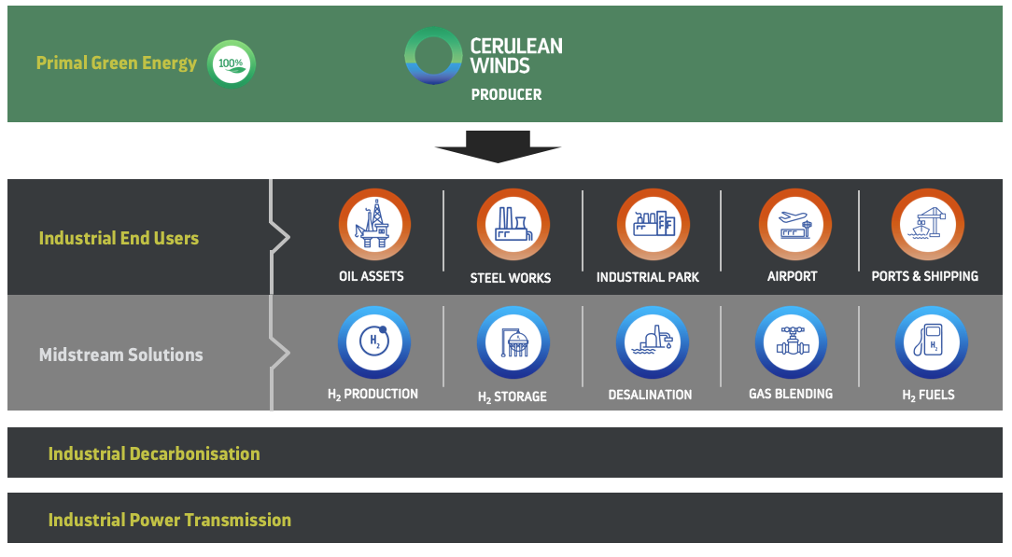
4. Defining the issue to be solved - Market segmentation
1
2
3

Slide 10
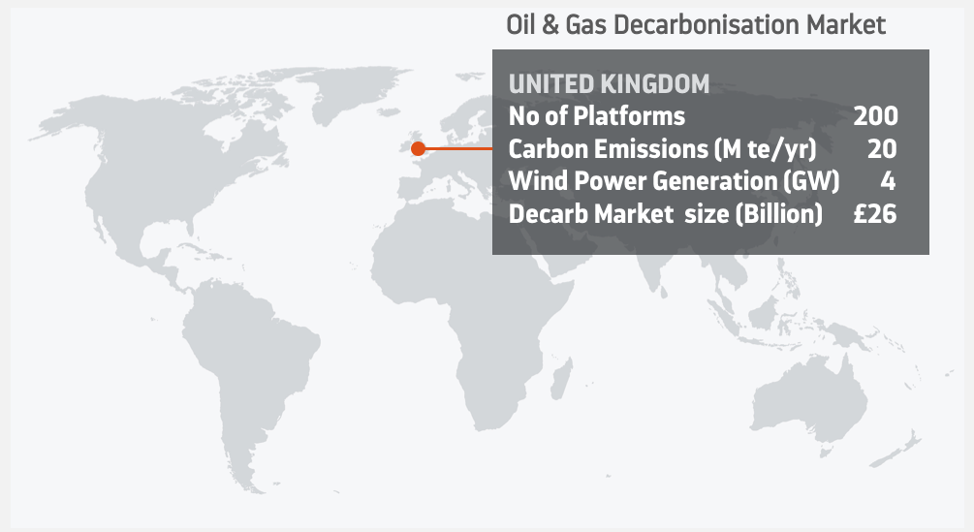
4. Defining the issue to be solved

Slide 11
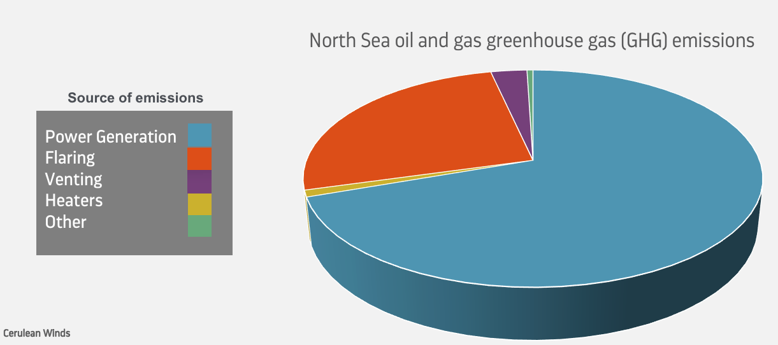
4. Defining the issue to be solved
2018 - 18.80 million tons
2022 - 15.03 million tons (Mainly through reduction in flaring)
OEUK 2022 report

Slide 12
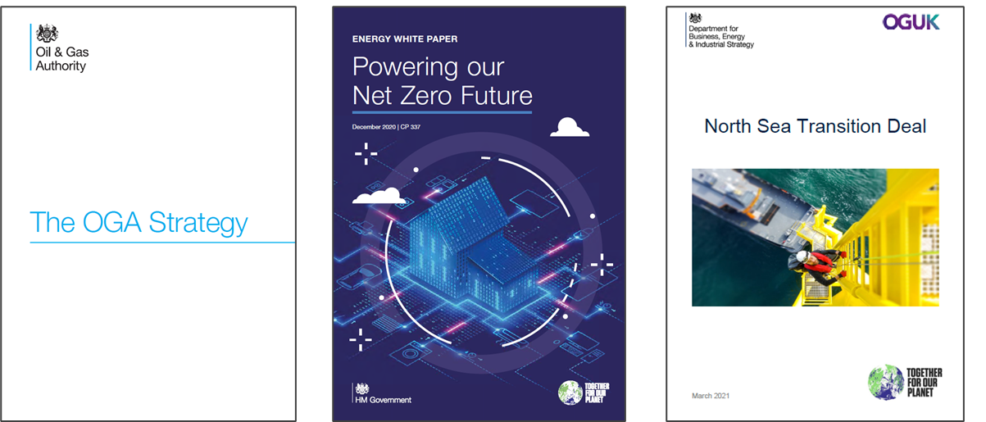
4. Defining the issue to be solved

Slide 13
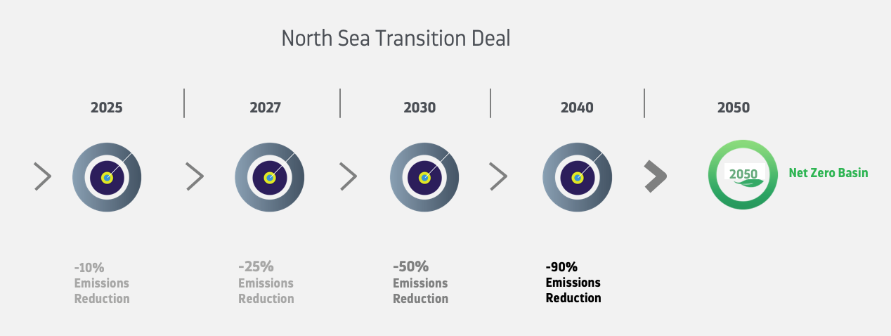
4. Defining the issue to be solved
Cerulean Winds

Slide 14
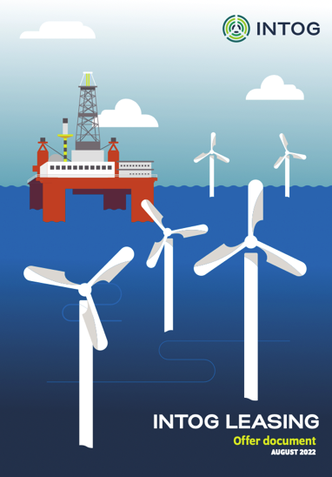
5. Creating the opportunity – INTOG leasing round
Designed in response to Government and industry to achieve targets of the North Sea Transition Deal (NSTD)

Slide 15
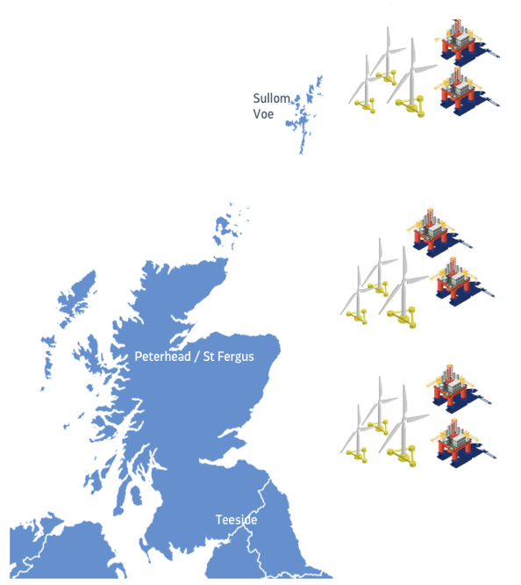
5. The basin-wide solution
North Sea.
Appx 200 operational platforms

Slide 16
6. Key stumble blocks and objections!
“Electrify the entire oil and gas north sea operations… it’s too complex”
O&G operators have their own agenda
The Government likes a step by step approach …try a single 14MW turbine
Who are Cerulean Winds?
How on earth are you going to deliver on that!

Slide 17
7. Stakeholder Communities (Just a few !)
INTOG Bid Process
Holyrood / Westminster
North Sea Transition Deal
Oil and Gas Operators
Regulators
Ports & Local Communities
Supply Chain – Local Content

Slide 18
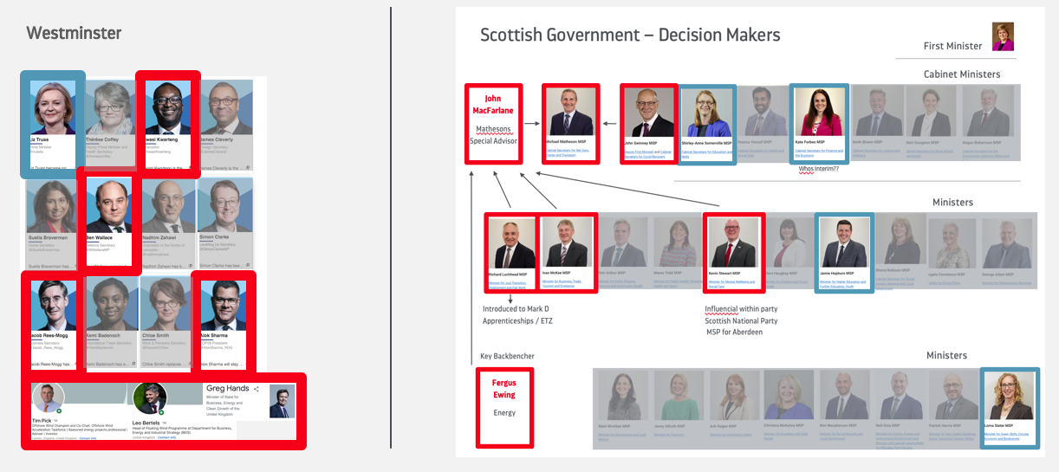
7. Stakeholder Communities - Governments
Cerulean Winds

Slide 19

8. Key Messages – benefits
Oil & Gas Operators
The Supply Chain
The Economy
Net Zero

Slide 20
8. Key Messages – The Just Transition
The Just Transition
The Outcomes of the ‘Just Transition’
Citizens, communities & place
Jobs, skills & Education
Fair distribution of costs & benefits
Business & Economy
Adaptation &
resilience
Environmental
protection & restoration
Decarbonisation &
efficiencies
Equality & human
rights implementation

Slide 21
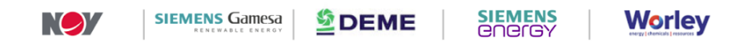
8. Key Messages – Project Delivery – Tier 1 contractor consortium
Cerulean Winds Scheme
Technical Solution
Technology
Delivery Consortium
Financial Credibility
Managed Risk

Slide 22
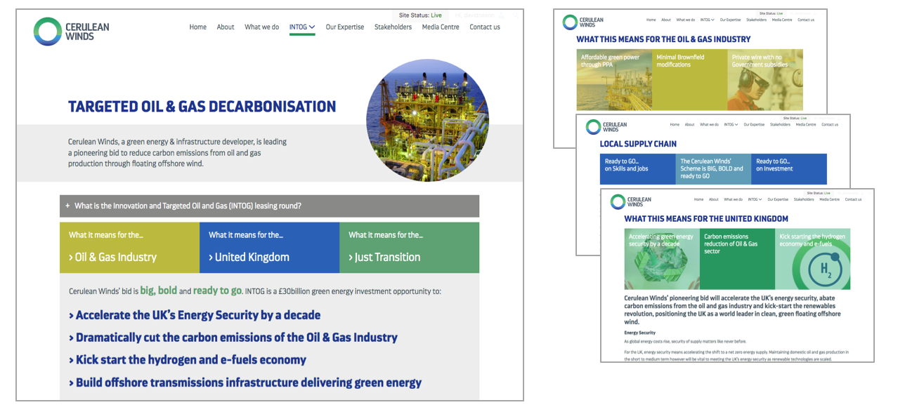
8. Key Messages – Projecting Online

Slide 23

8. Key Messages – Campaign to deliver the messages

Slide 24

8. Key Messages – Campaign – ready to go

Slide 25

8. Key Messages – Campaign – Scottish Government/Local Content

Slide 26
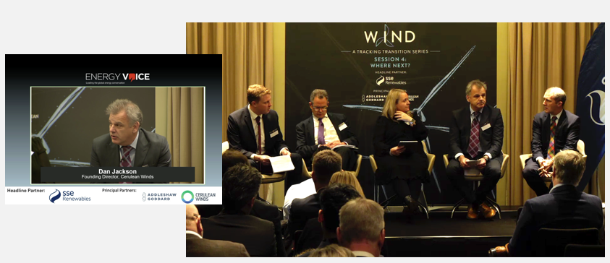
8. Key Messages – The day before the INTOG submission deadline

Slide 27
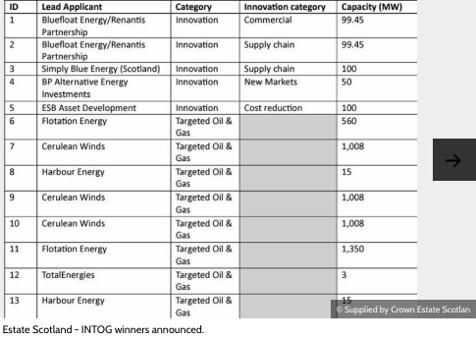

9. The Lease Win – March 2023

Slide 28
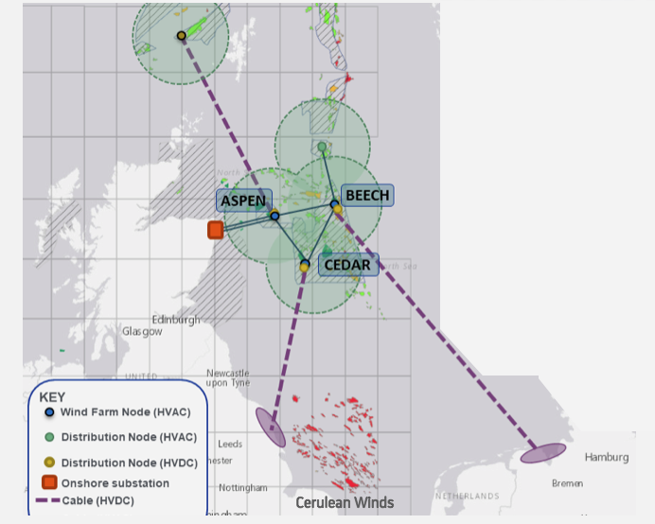
9. The Lease Win – Development of the North Sea Renewables Grid

Slide 29
10. Benefits to SMEs and start-ups
Big industry is siloed
New opportunities
Be a disruptor
Be prepared to hit brick walls

Slide 30
Thank you
Energy transition - brand activation
David Nason
Brand, marketing and stakeholder communications consultant
david@nasonassociates.co.uk

